Slide 1
Discrete Structures
CS-1005
GCR: e2d2awt
Lecture-7

Slide 2
Rule of Inference
A rule of inference is a logical tool used in formal reasoning that allows one to derive a conclusion from one or more premises (statements assumed to be true). It is a fundamental concept in logic, mathematics, and computer science, providing a systematic way to determine the validity of arguments.

Slide 3
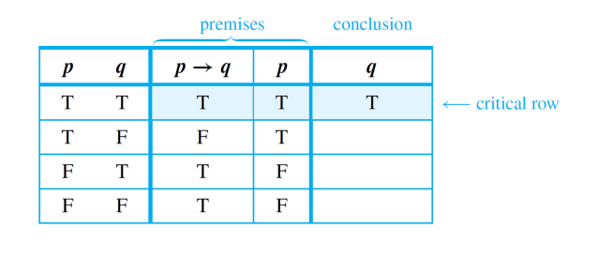
Rules of Inference
Rule of Inference
Modus Ponens
p → q
If the computer is on, the monitor will display something
The computer is on.
Therefore, the monitor will display something
p
∴ q

Slide 4
Rules of Inference
Rule of Inference
Modus Tollens
p → q
If Ali is human, then he is mortal
Ali is not mortal
∴ Ali is not human
∼ q
∴ ∼ p
p | q | p-> q | ~q | ~p
T | T | T | F | F
T | F | F | T | F
F | T | T | F | T
F | F | T | T | T
premises
conclusion

Slide 5
Rule of Inference
Use modus ponens or modus tollens to fill in the blanks of the following arguments so that they become valid inferences.
If there are more pigeons than there are pigeonholes, then at least two pigeons roost in the same hole. There are more pigeons than there are pigeonholes.
.
If 870,232 is divisible by 6, then it is divisible by 3. 870,232 is not divisible by 3.
.

Slide 6


Rule of Inference
At least two pigeons roost in the same hole.
870,232 is not divisible by 6.

Slide 7
Rule of Inference
A rule of inference is a form of argument that is valid. Thus modus ponens and modus tollens are both rules of inference.
The following are additional examples of rules of inference that are frequently used in deductive reasoning.

Slide 8
Rules of Inference
Rule of Inference
Generalization
p
∴ p ∨ q
Ann is a junior
∴ Ann is a junior or an alien.
q
∴ p ∨ q
Ann is an alien
∴ Ann is a junior or an alien.
ence

Slide 9
Rules of Inference (1)
Rule of Inference
Specialization
p ∧ q
p ∧ q
∴ p
∴ q
Ex.: Ann knows math and physics
∴ Ann knows math

Slide 10
Rules of Inference (1)
Rule of Inference
Elimination
p ∨ q p ∨ q
∼ p ∼ q
∴ q ∴ p
Today is Saturday or today is Sunday
Today is not Saturday
∴ Today is Sunday
For instance suppose you know that for number x,
x-3=0 or x+2=0 .
If you also know that x is not negative, then x≠-2, so x+2≠0
By elimination, you can conclude that x-3=0

Slide 11
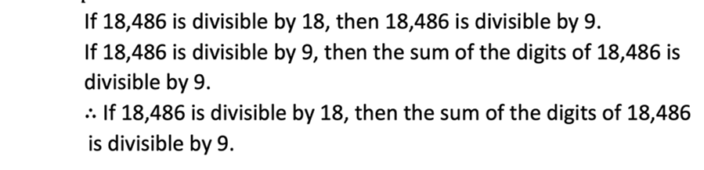
Rule of Inference
Rules of Inference (2)
Transitivity
p → q
q → r
∴ p → r
If today is Friday then Today is holiday
If today is holiday then I am happy
∴ If today is Friday then I am happy

Slide 12
Rules of Inference (2)
Rule of Inference
Transitivity
Proof by division into cases
p ∨ q
x is positive or negative. If x is positive, then x² > 0. If x is negative, then x² > 0.
∴ x² > 0.
p → r
q → r
∴ r
Today is Friday or today is Sunday
If today is Friday then I am happy
If today is Sunday then I am happy
∴ I am happy
ence

Slide 13
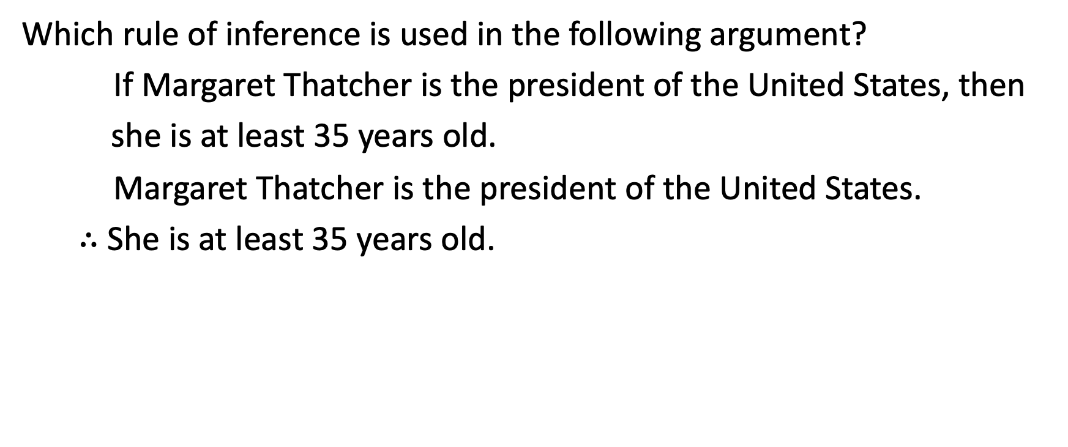
Examples:
Rule of Inference

Slide 14
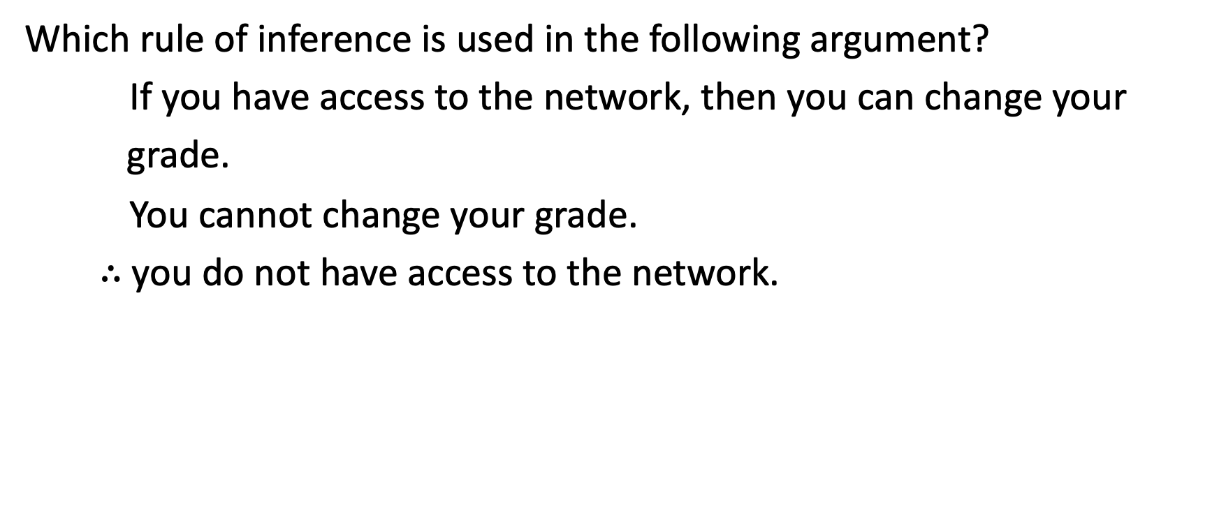
Examples:
Rule of Inference

Slide 15
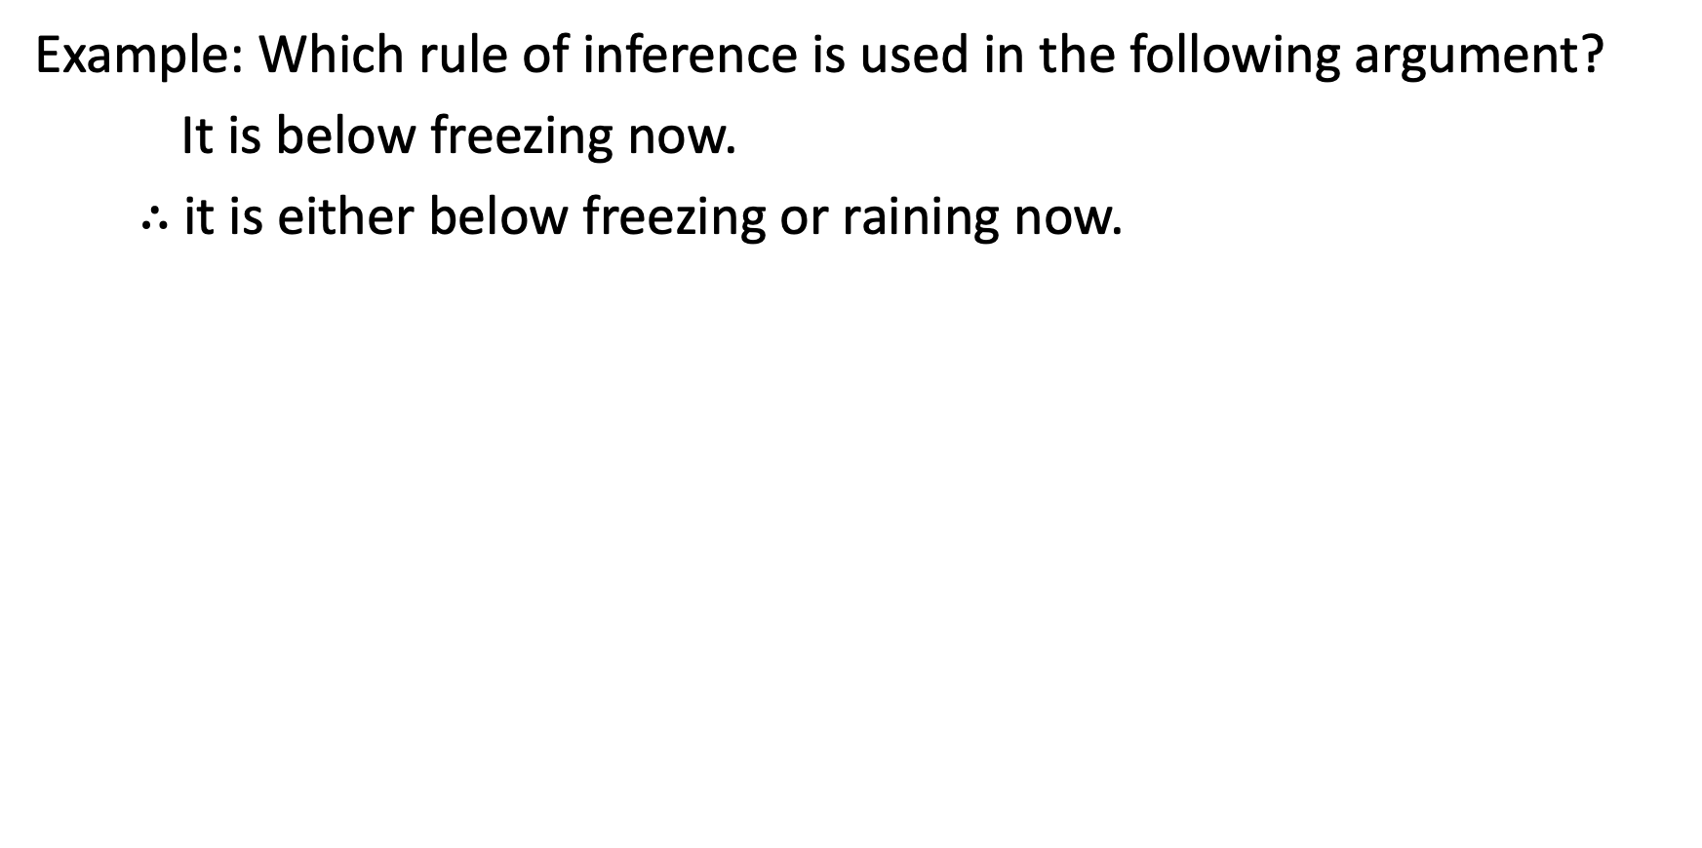
Examples:
Rule of Inference

Slide 16
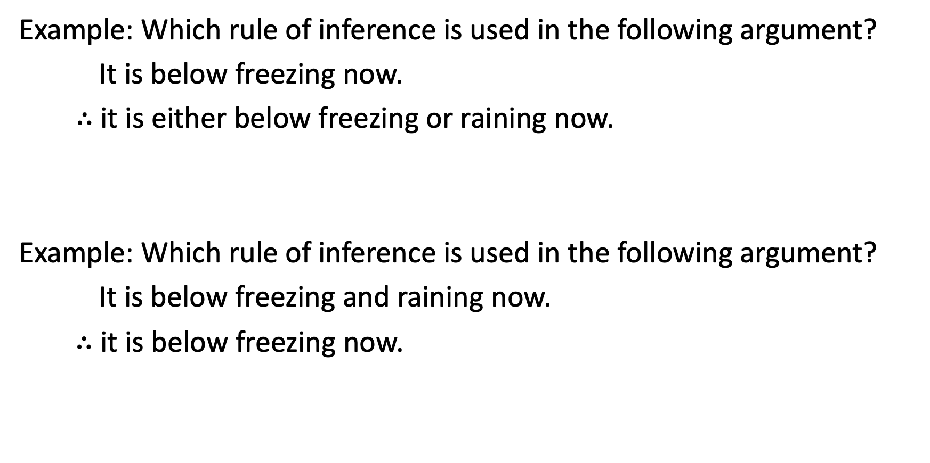
Examples:
Rule of Inference

Slide 17
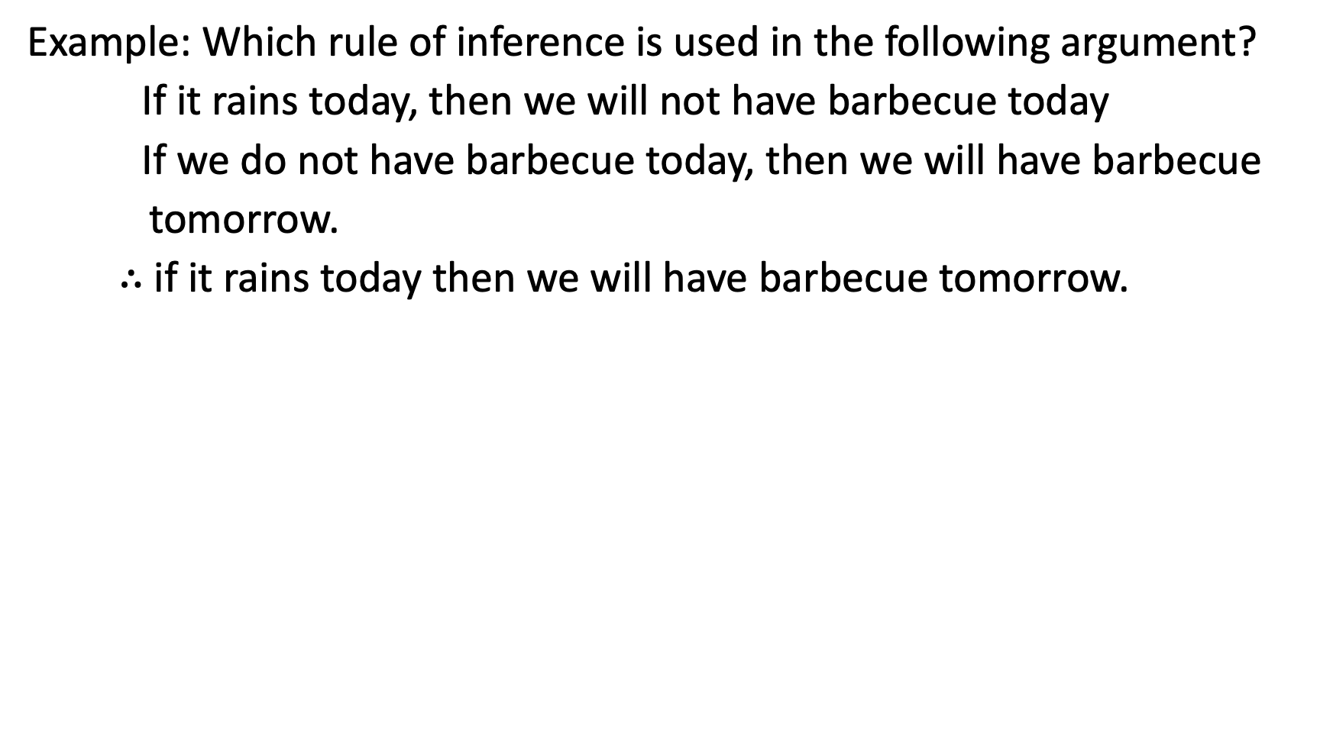
Examples:
Rule of Inference

Slide 18
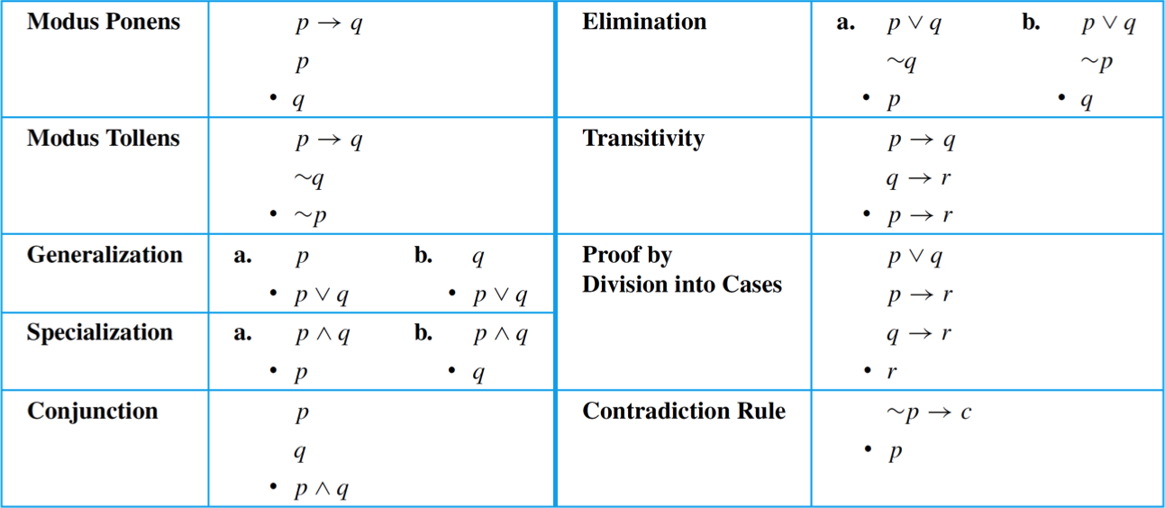
Examples:
Rule of Inference

Slide 19
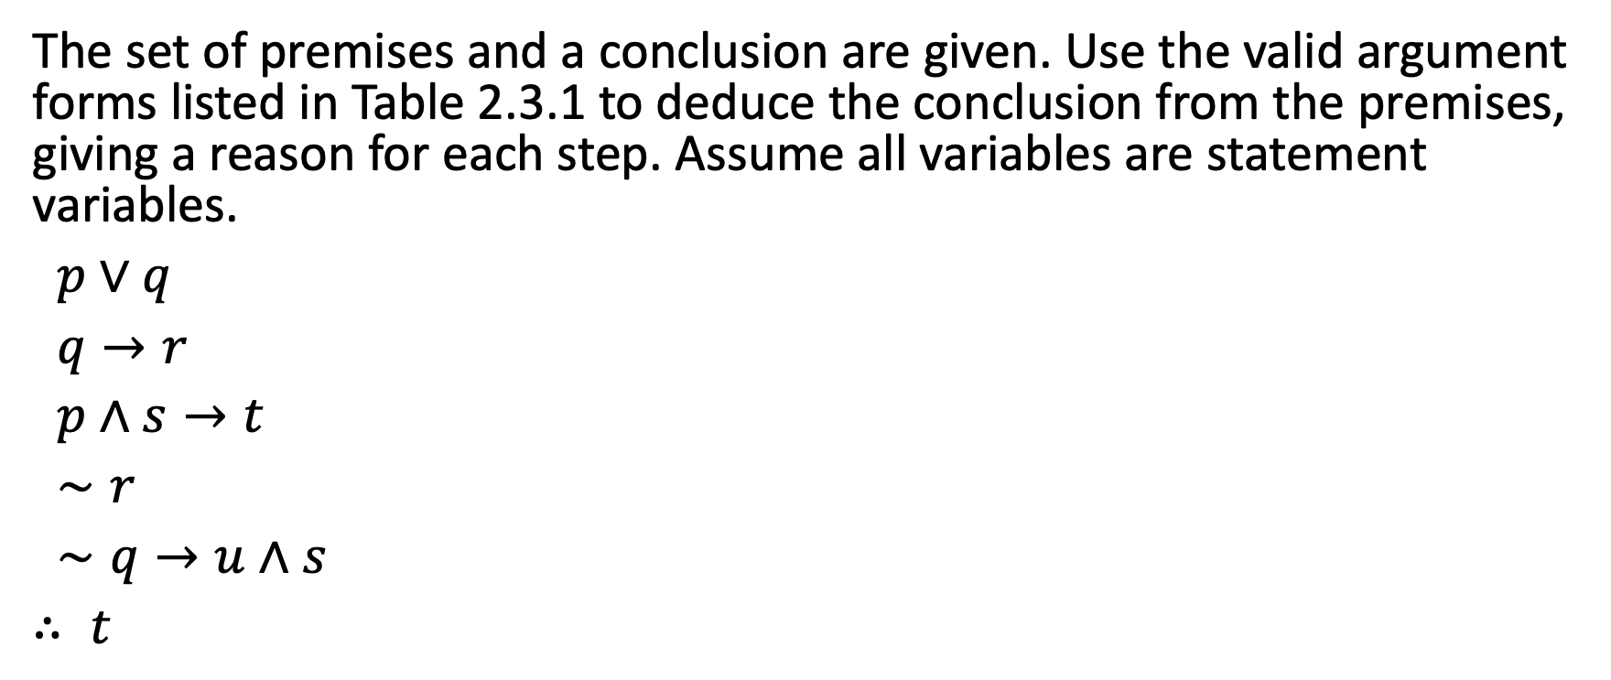
Rule of Inference

Slide 20



Slide 21
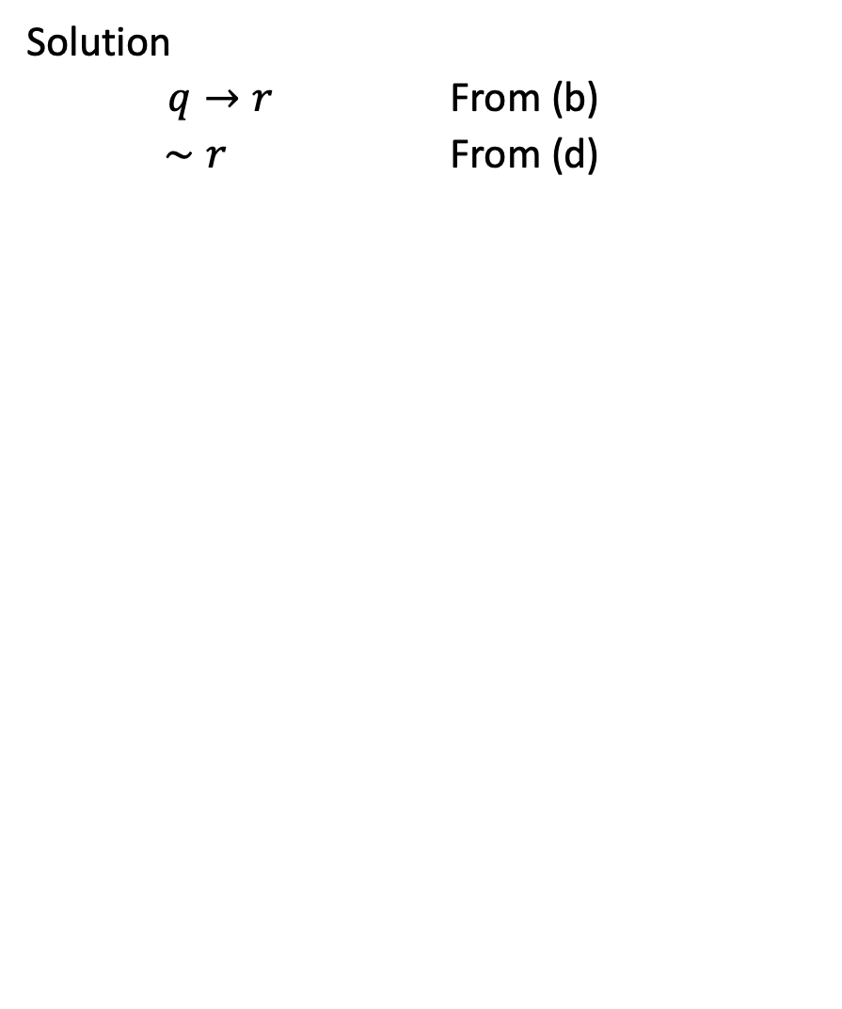

Slide 22
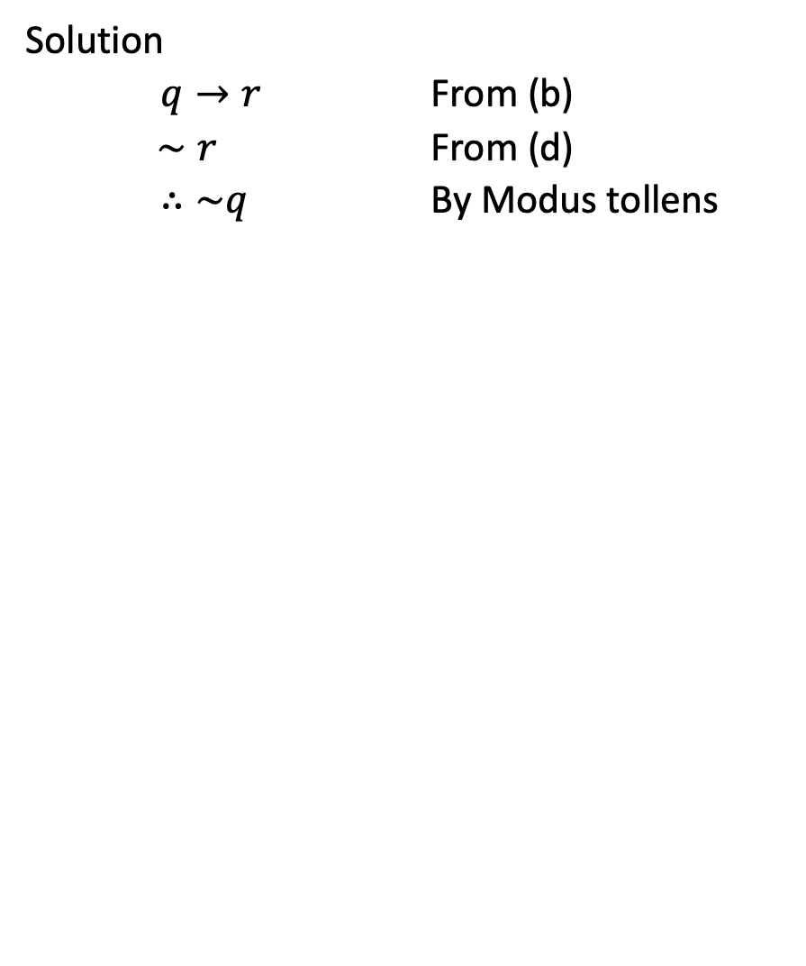

Slide 23
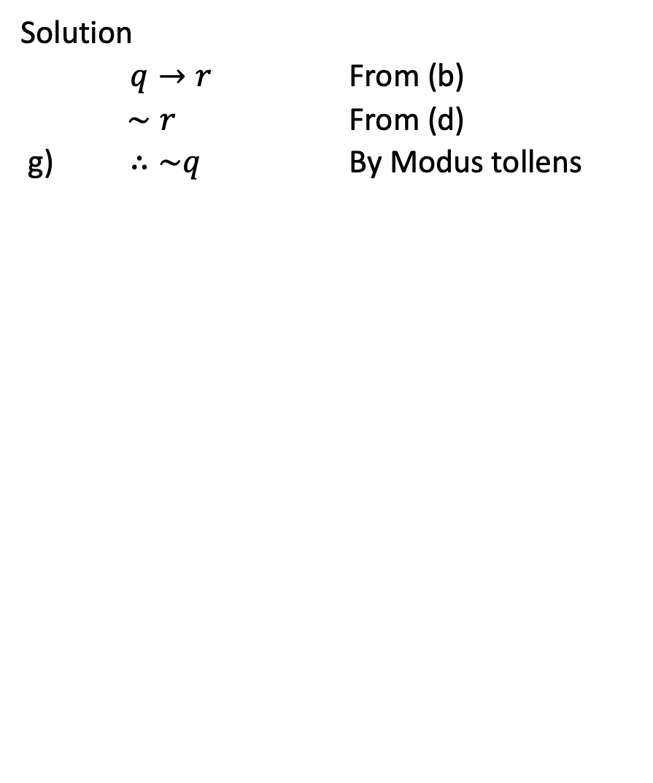

Slide 24
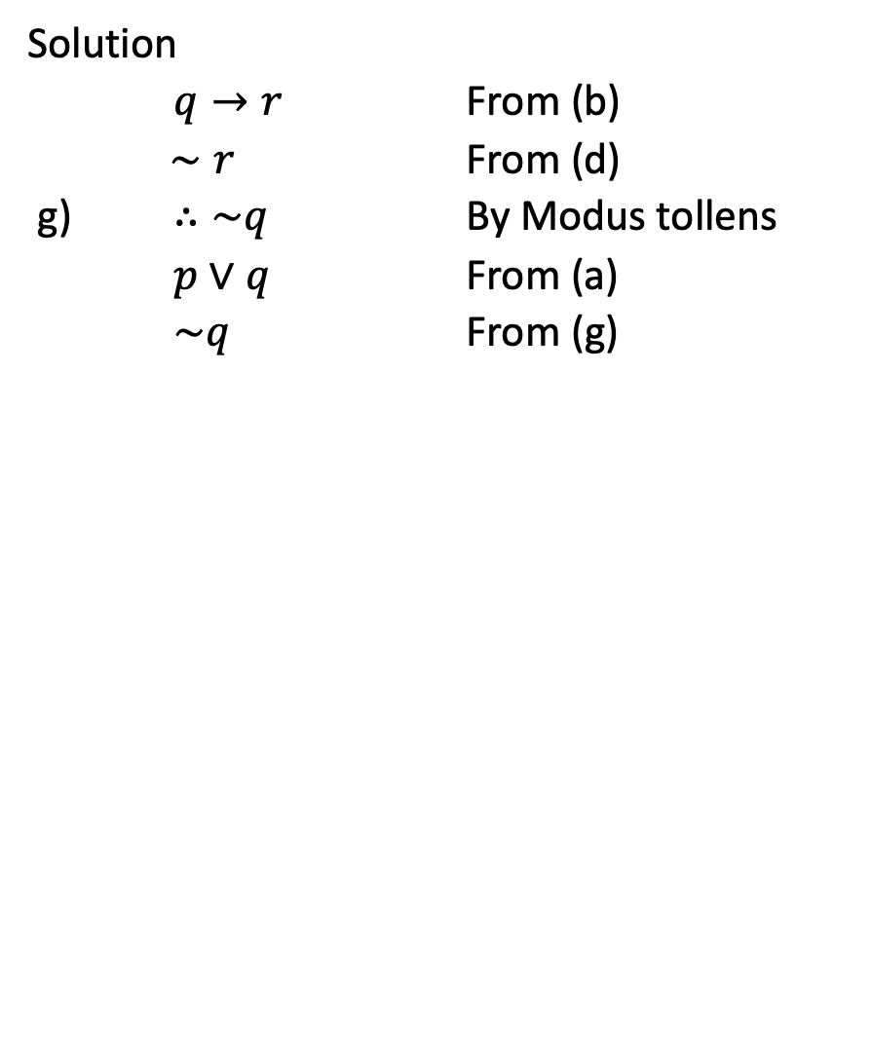

Slide 25
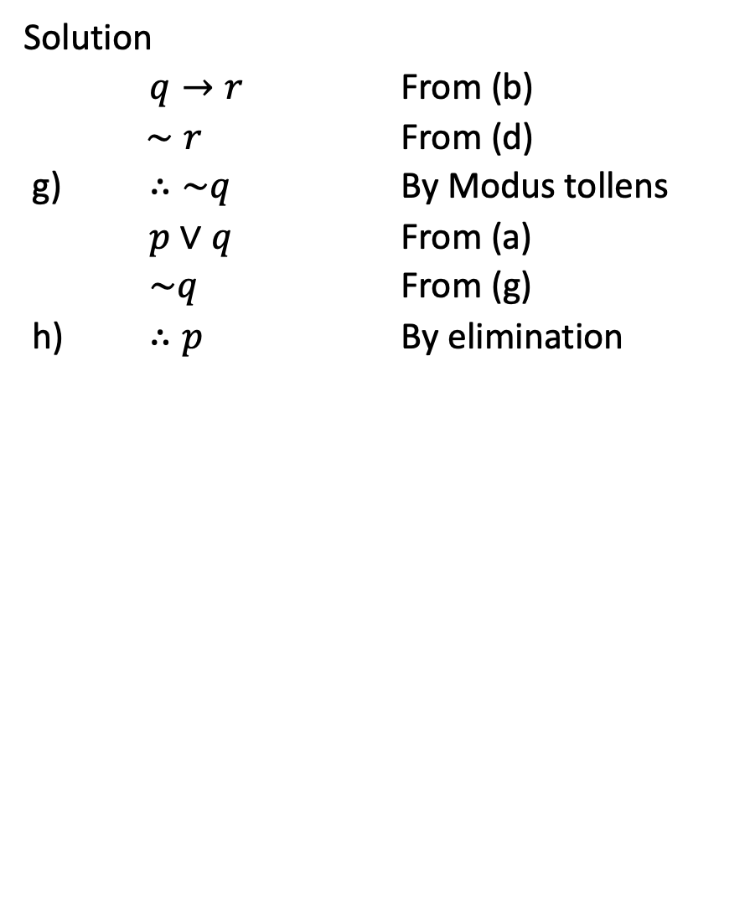

Slide 26
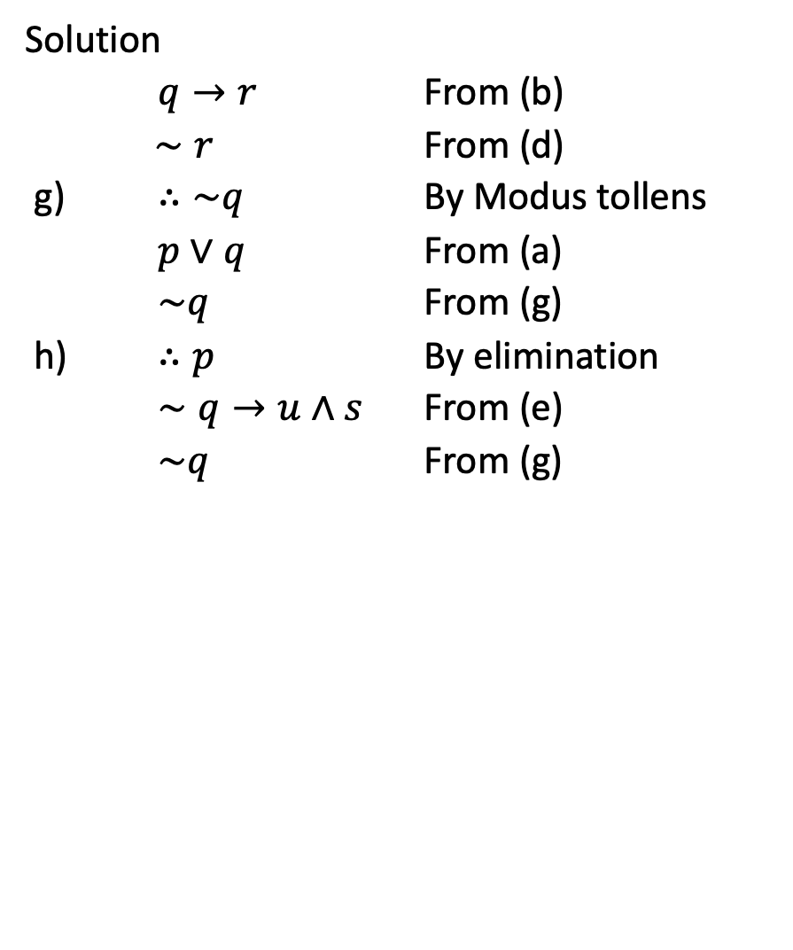

Slide 27
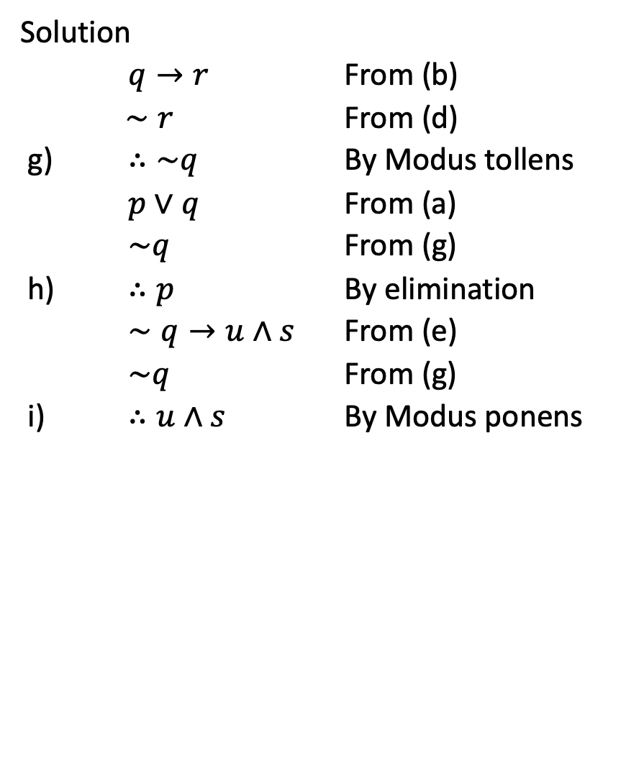

Slide 28
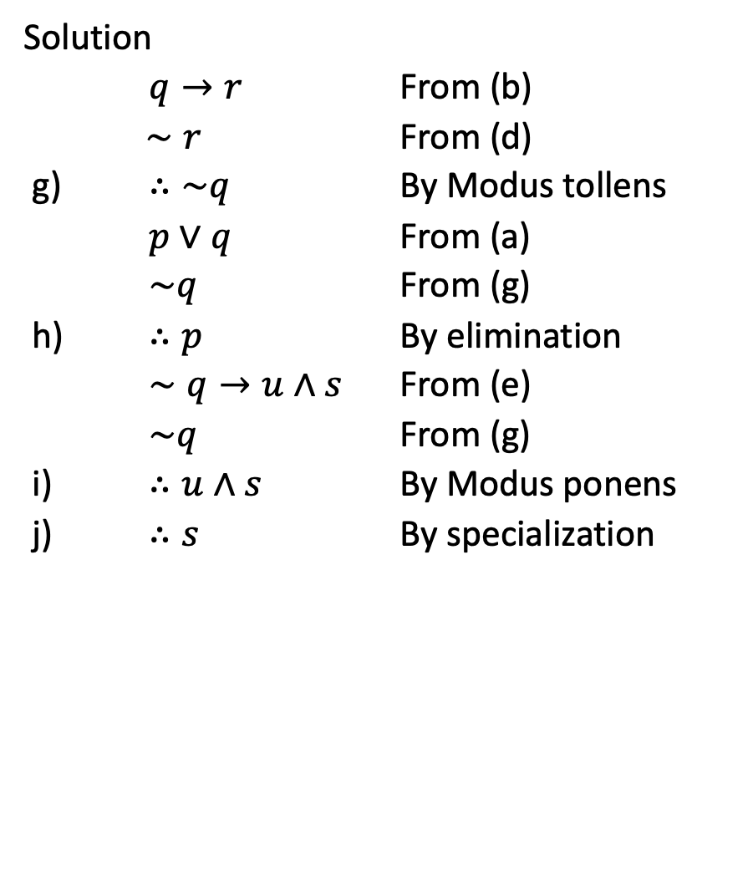

Slide 29
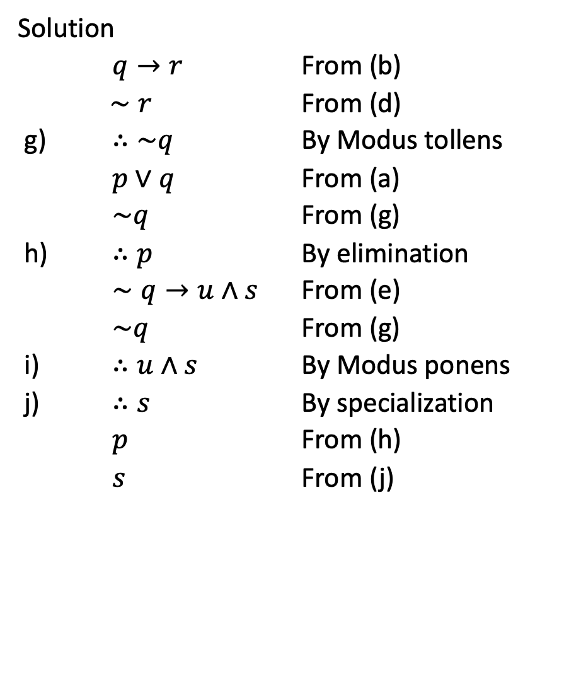

Slide 30
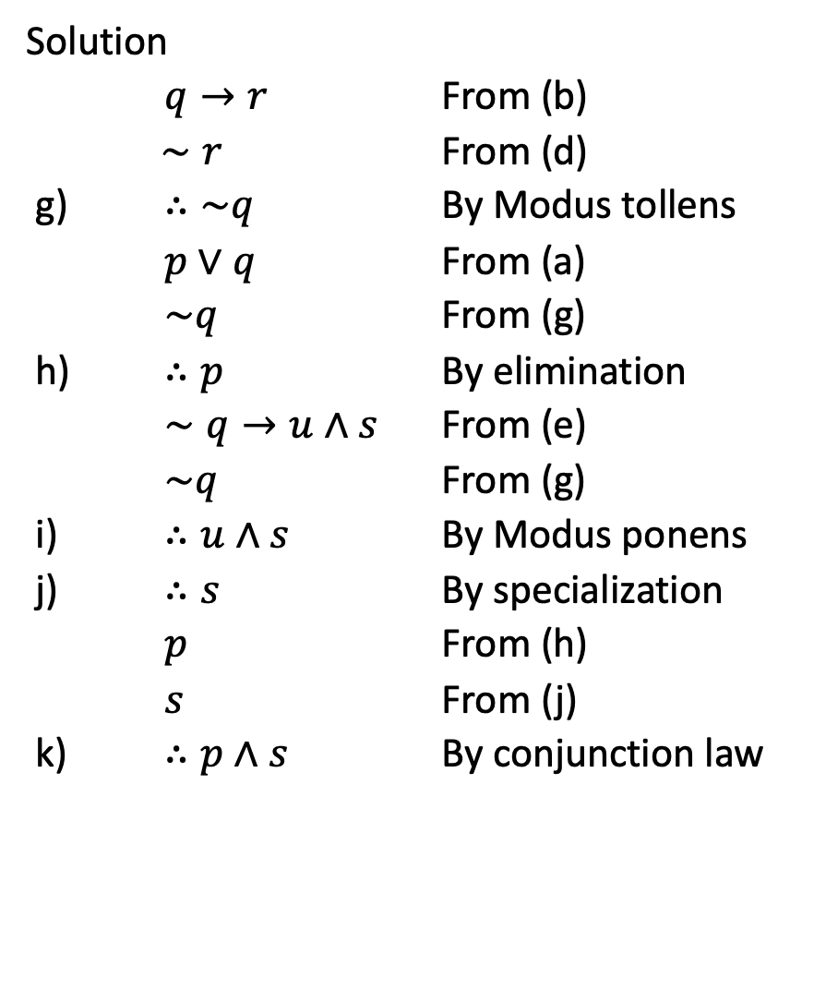

Slide 31
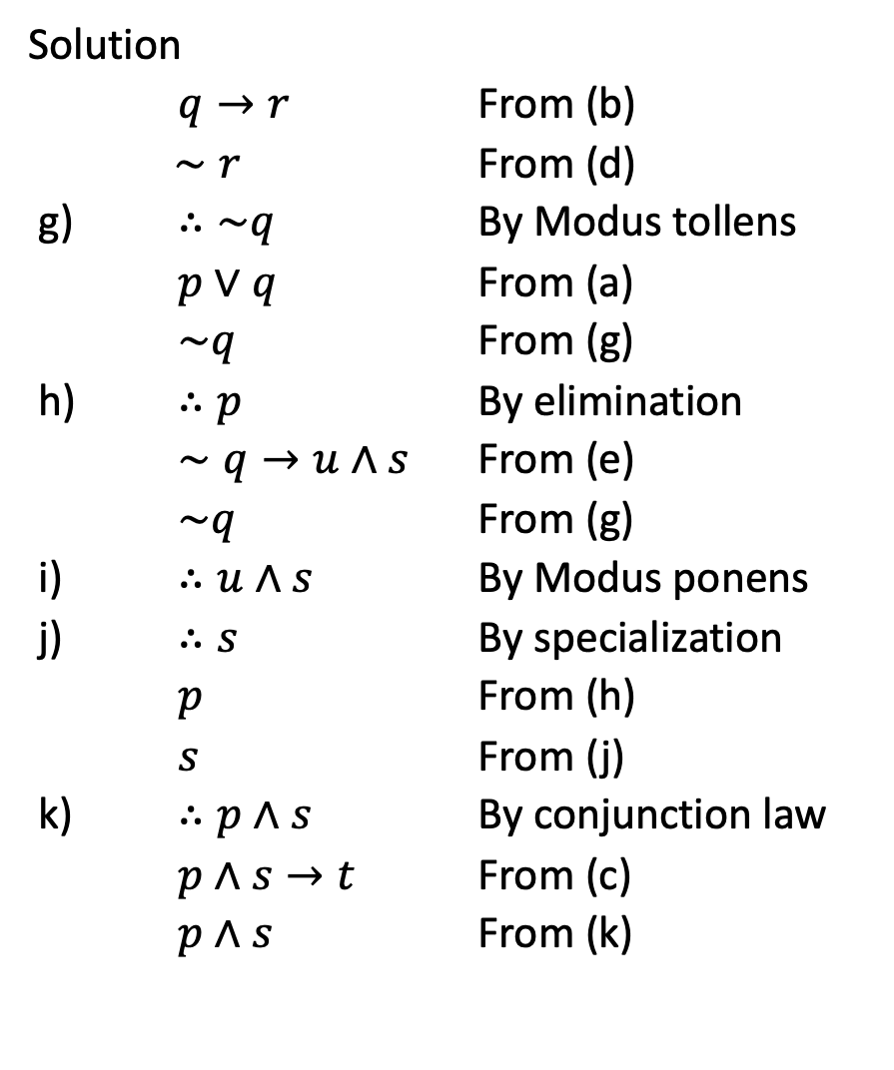

Slide 32
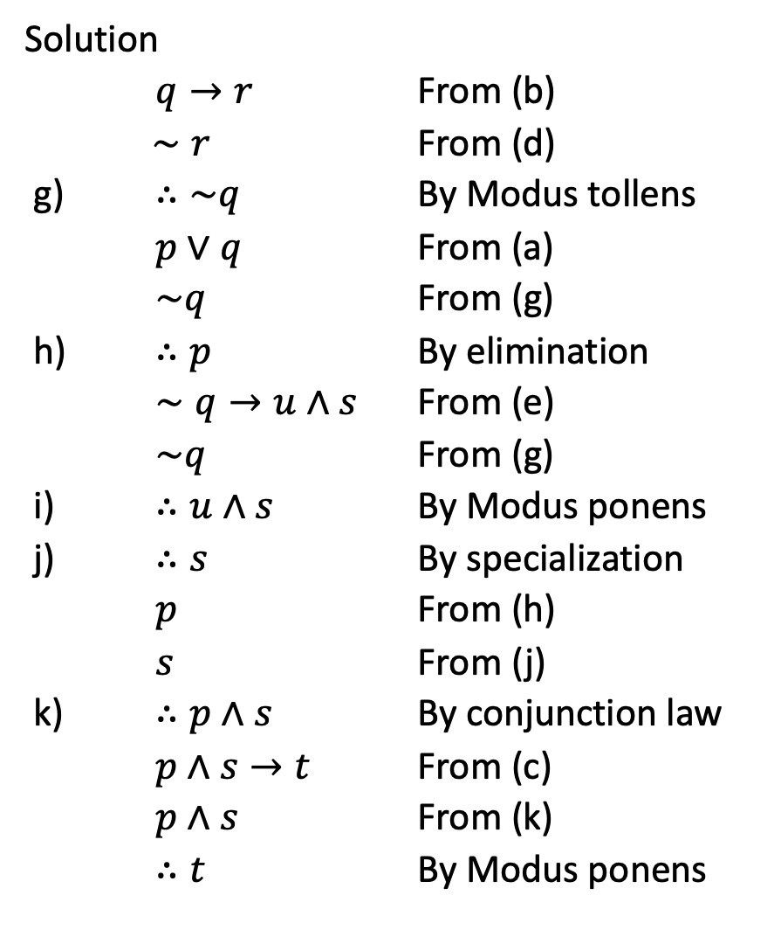

Slide 33
Rule of Inference
You are about to leave for school in the morning and discover that you don’t have your glasses. You know the following statements are true:
If I was reading the newspaper in the kitchen, then my glasses are on the kitchen table.
If my glasses are on the kitchen table, then I saw them at breakfast.
I did not see my glasses at breakfast.
d. I was reading the newspaper in the living room or I was reading the newspaper in the kitchen.

Slide 34
Rules of Inference
e. If I was reading the newspaper in the living room then my glasses are on the coffee table.
Where are the glasses?
Solution:
Let RK = I was reading the newspaper in the kitchen.
GK = My glasses are on the kitchen table.
SB = I saw my glasses at breakfast.
RL = I was reading the newspaper in the living room.
GC = My glasses are on the coffee table.

Slide 35





Example 8 – Application: A More Complex Deduction
You are about to leave for school in the morning and discover that you don’t have your glasses. You know the following statements are true:
If I was reading the newspaper in the kitchen, then my glasses are on the kitchen table.
b. If my glasses are on the kitchen table, then I saw them at breakfast.
c. I did not see my glasses at breakfast.
d. I was reading the newspaper in the living room or I was reading the newspaper in the kitchen.
e. If I was reading the newspaper in the living room then my glasses are on the coffee table.
Where are the glasses?
30

Slide 36











Example 8 – Solution
cont’d
Here is a sequence of steps you might use to reach the answer, together with the rules of inference that allow you to draw the conclusion of each step:
1.
2.

Slide 37












Example 8 – Solution
cont’d
3.
4.
Thus the glasses are on the coffee table.

Slide 38
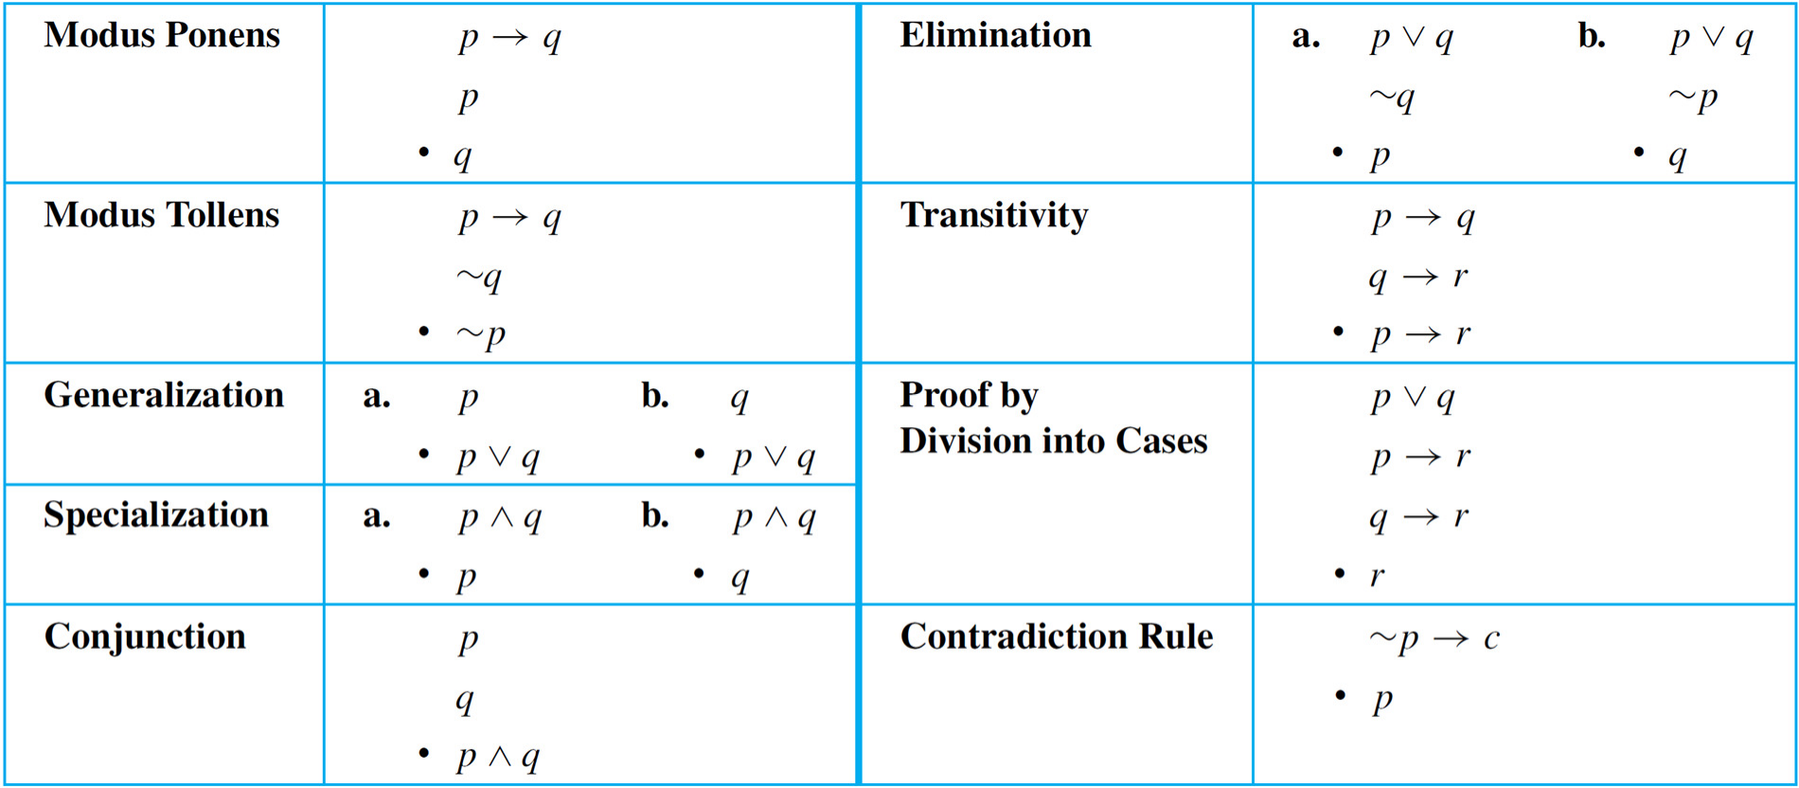
Rule of Inference

Slide 39
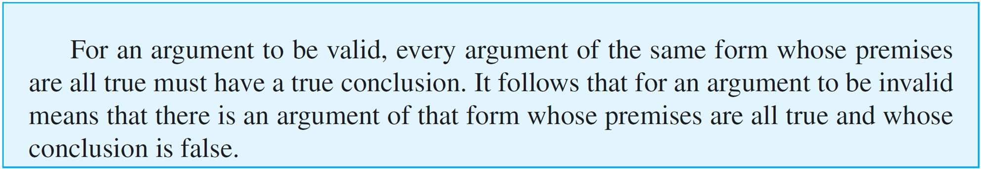
Fallacies
A fallacy is an error in reasoning that results in an invalid argument. Three common fallacies are using ambiguous premises, and treating them as if they were unambiguous, circular reasoning (assuming what is to be proved without having derived it from the premises), and jumping to a conclusion (without adequate grounds).

Slide 40
Converse Error
Show that the following argument is invalid:
If Zeke is a cheater, then Zeke sits in the back row. Zeke sits in the back row.
∴ Zeke is a cheater.
Solution:
Many people recognize the invalidity of the above argument intuitively, reasoning something like this:
The first premise gives information about Zeke if it is known he is a cheater. It doesn’t give any information about him if it is not already known that he is a cheater.

Slide 41
Converse Error
One can certainly imagine a person who is not a cheater but happens to sit in the back row. Then if that person’s name is substituted for Zeke, the first premise is true by default and the second premise is also true but the conclusion is false.
The general form of the previous argument is as follows:
p → q
q
∴ p

Slide 42
Fallacies
The fallacy underlying this invalid argument form is called the converse error because the conclusion of the argument would follow from the premises if the premise
p → q were replaced by its converse.
Such a replacement is not allowed, however, because a conditional statement is not logically equivalent to its converse. Converse error is also known as the fallacy of affirming the consequent.
Another common error in reasoning is called the inverse error.

Slide 43
Inverse Error
Consider the following argument:
If interest rates are going up, stock market prices will go down.
Interest rates are not going up.
Stock market prices will not go down.
Note that this argument has the following form:
p → q
∼p
∼q
∴

Slide 44
Fallacies
The fallacy underlying this invalid argument form is called the inverse error because the conclusion of the argument would follow from the premises if the premise p → q were replaced by its inverse.
Such a replacement is not allowed, however, because a conditional statement is not logically equivalent to its inverse. Inverse error is also known as the fallacy of denying the antecedent.

Slide 45
Example – A Valid Argument with a False Premise and a False Conclusion
The argument below is valid by modus ponens. But its major premise is false, and so is its conclusion.
If John Lennon was a rock star, then John Lennon had red hair.
John Lennon was a rock star.
John Lennon had red hair.

Slide 46
Example – An Invalid Argument with True Premises and a True Conclusion
The argument below is invalid by the converse error, but it has a true conclusion.
If New York is a big city, then New York has tall buildings.
New York has tall buildings.
New York is a big city.

Slide 47
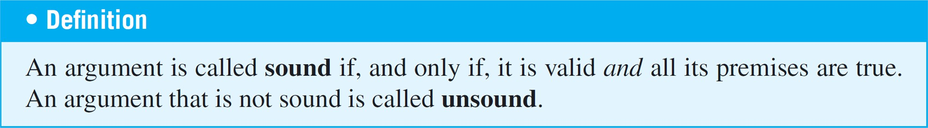
Sound Arguments

Slide 48
Sound Arguments
Sometimes people lump together the ideas of validity and truth. If an argument seems valid, they accept the conclusion as true. And if an argument seems fishy (really a slang expression for invalid), they think the conclusion must be false. This is not correct!
An argument is called sound if, only if,
1 It is valid, and
2 All its premises are true.
Example
If John Lennon was a rock star, then John Lennon had red hair. John Lennon was a rock star.
∴ John Lennon had red hair.
An argument that is not sound is called unsound.

